Slide 1
Session 9 Fitting models to data

Slide 2
Aims and objectives
Aim: Applying model calibration methods to estimate parameters
Objectives
Key terms about model fitting
Least squares method
Maximum likelihood estimation
Bayesian inference
Optimization algorithms

Slide 3
Model development steps
Identify the question
Identify existing knowledge
Choose model structure
Choose modelling method
Model quantification
Model validation
Prediction and optimization
Decision making
Notes:
To give reliable assumption, model parameters without enough knowledge should be inferred using empirical data.
It is called model calibration, fitting model, parameter estimation.

Slide 4
Model calibration steps
Which parameters should be calibrated?
Which data should be targeted for fitting?
How do we decide whether a model
provides a “good” fit to data?
How do we find the “best fitting” parameters?
Integrate the calibrated parameters into the model

Slide 5
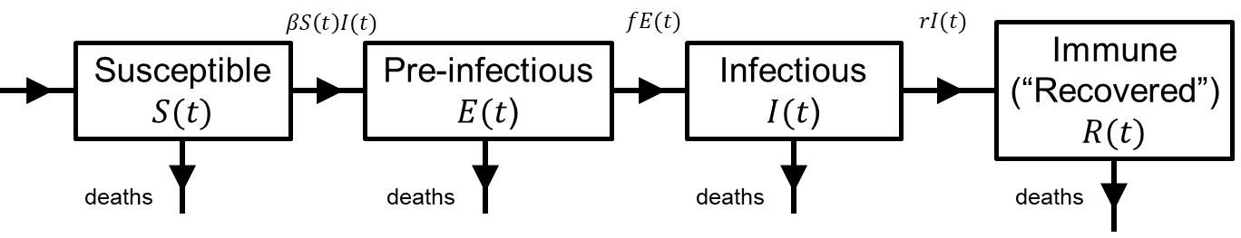
Introduction
Infectious Disease
models
Structure
Parameters and initial conditions
Data to fit to

Slide 6
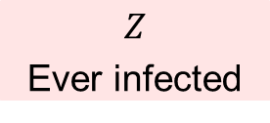
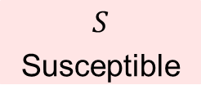



Example: Catalytic Model
$$S$$
Susceptible
$$λ$$
$$Z$$
Ever infected
Structure
Parameters
Force of infection $λ$
Initial conditions
$S\left(0\right)=1$ $Z\left(0\right)=0$
Data to fit to

Slide 7
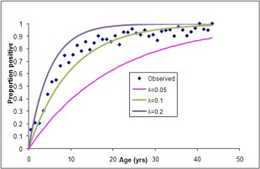
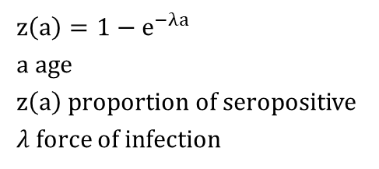

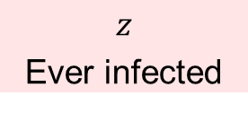
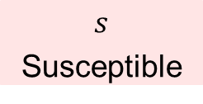
Example: Catalytic Model
Structure
$$s$$
Susceptible
$$λ$$
$$z$$
Ever infected
Parameters
$s\left(0\right)=1$ $z\left(0\right)=0$
Initial conditions
Data to fit to
$$z\left(a\right)=1−e^{−λa}$$
a age
$z\left(a\right)$ proportion of seropositive $λ$ force of infection

Slide 8
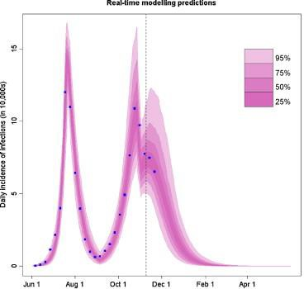
Example: H1N1 Model
(Baguelin, Van Hoek et al. Vaccine 2010; 28:2370)
Number of influenza A/H1N1v infections in England:
Case estimates until 15 Nov (blue dots)
Fitted model predictions (pink shades)
Uncertainty intervals for model predictions
Notes:
Baguelin M, van Hoek AJ, Jit M, Flasche S, White PJ, Edmunds WJ. Vaccination against pandemic influenza A/H1N1v in England: a real-time economic evaluation. Vaccine 2010; 28(12):2370-84

Slide 9
Terminology
Parameterization (Quantification) | Giving values to the parameters in a model (by whatever means eg. guessing, directly from the literature, fitting to data)
Fitting (Calibration) | Parameterization of a model by finding a parameter set that produces model results with a “good fit” to outcome data
Validation | Comparing results of a parameterized model to data to see if the results are “valid” (either have face validity or satisfy some statistical test)
Sensitivity analysis | Altering the parameters of a model to see what effect this has on results

Slide 10
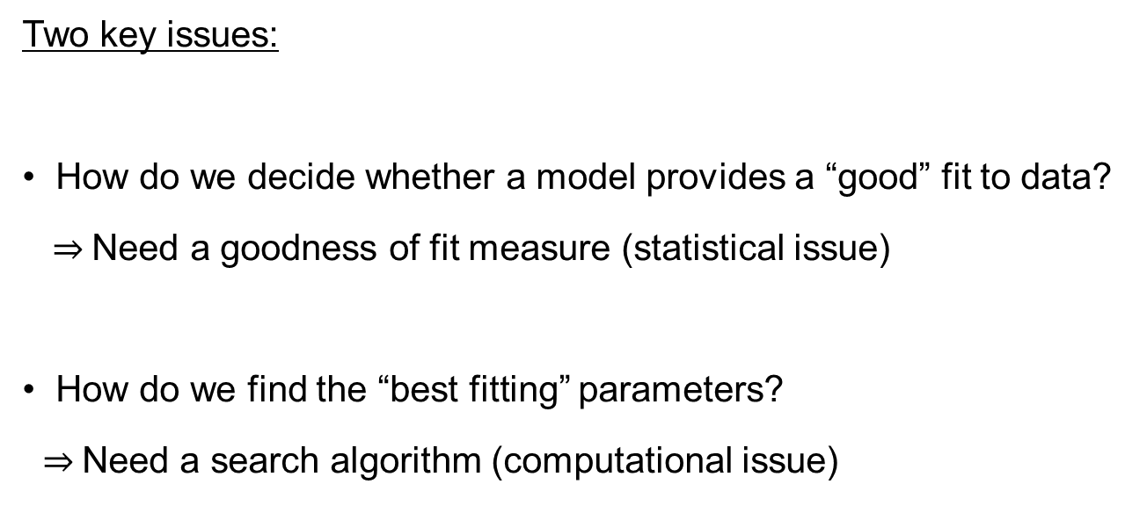
Fitting process
Two key issues:
How do we decide whether a model provides a “good” fit to data?
$⇒$Need a goodness of fit measure (statistical issue)
How do we find the “best fitting” parameters?
$⇒$Need a search algorithm (computational issue)

Slide 11
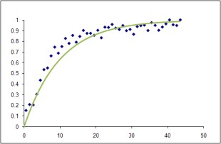
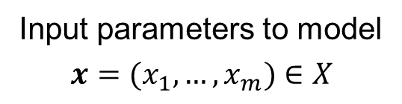
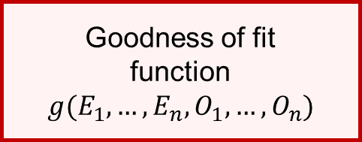

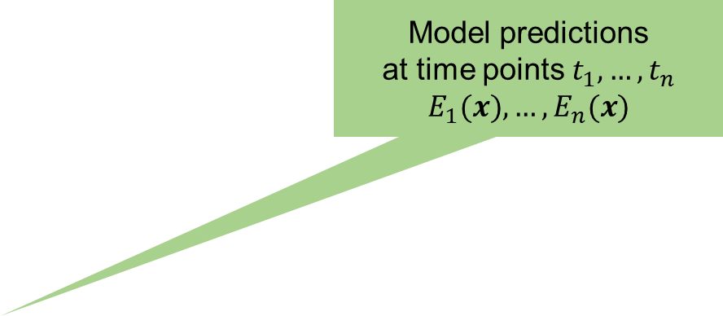
Goodness of fit
Input parameters to model
$$x=(x_{1},…,x_{m})∈X$$
Model predictions
at time points $t_{1},…, t_{n}$
$$E_{1}(x), …,E_{n}(x)$$
Model
Observed data at time points $t_{1},…,t_{n}$
$$O_{1},…,O_{n}$$
Goodness of fit
function
$$g(E_{1},…,E_{n}, O_{1},…, O_{n})$$

Slide 12
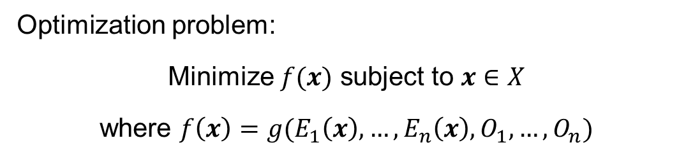
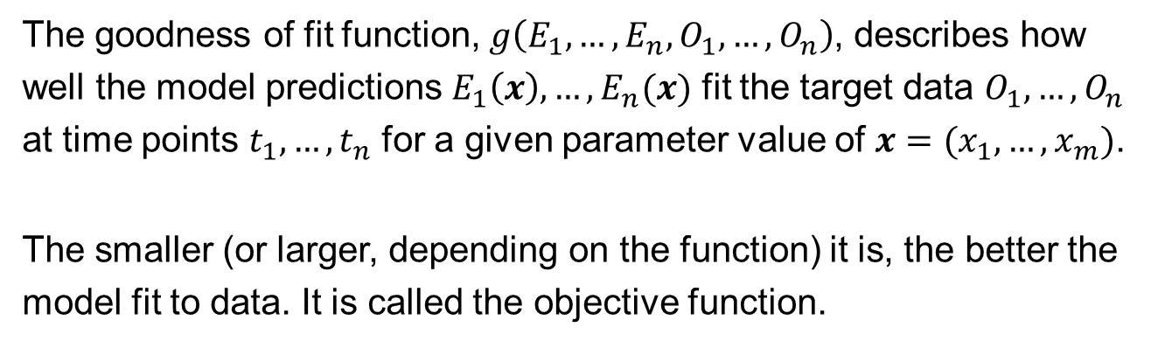
Goodness of fit
The goodness of fit function, $g\left(E_{1},…,E_{n},O_{1},…,O_{n}\right)$, describes how well the model predictions $E_{1}\left(x\right),…,E_{n}(x)$ fit the target data $O_{1},…,O_{n}$ at time points $t_{1},…,t_{n}$ for a given parameter value of $x=(x_{1},…,x_{m})$.
The smaller (or larger, depending on the function) it is, the better the model fit to data. It is called the objective function.
Optimization problem:
Minimize $f(x)$ subject to $x∈X$
where $f\left(x\right)=g(E_{1}\left(x\right),…,E_{n}\left(x\right),O_{1},…,O_{n})$

Slide 13
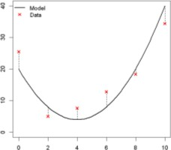
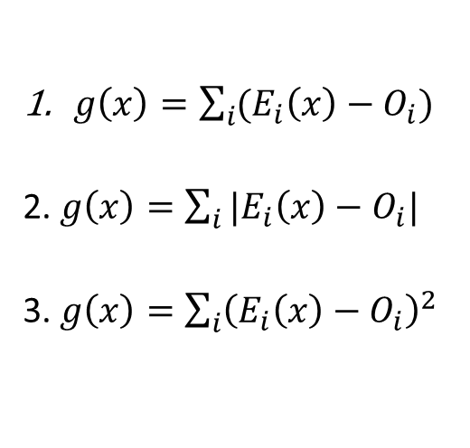
Least squares method
$g\left(x\right)=\sum_{i}{(E_{i}\left(x\right)−O_{i})}$
2. $g\left(x\right)=\sum_{i}{|E_{i}\left(x\right)−O_{i}|}$
3. $g\left(x\right)=\sum_{i}{{\left(E_{i}\left(x\right)−O_{i}\right)}^{2}}$
Linear distance (residual): Positive and negative distances cancel out
Absolute distance: Strange behavior at zero makes the function difficult to deal with both analytically and computationally
Squared distances (residual sum of squares: SSR)
⇒ Least squares method

Slide 14

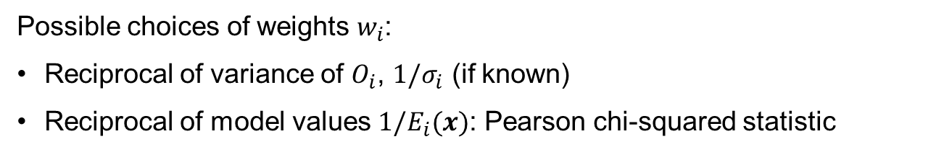
Least squares method
It is very popular because simple, intuitive and easy to implement
No assumptions needed for how deviance occurs
If the deviance of data is independent and normally distributed, it is the same as maximum likelihood estimation
The SSR doesn’t actually tell us how “good” a fit the model is to data
We are not taking into account how uncertain we are about our data
Weighted least squares method
$$g\left(x\right)=\sum_{i}{w_{i}{\left(E_{i}\left(x\right)−O_{i}\right)}^{2}}$$
Possible choices of weights $w_{i}$:
Reciprocal of variance of $O_{i}$, $1/σ_{i}$ (if known)
Reciprocal of model values $1/E_{i}(x)$: Pearson chi-squared statistic

Slide 15
Maximum likelihood estimation (MLE)
What is “likelihood”?
Q: What are the parameter values which give the “best fit” to the observed data, given the model?
Likelihood is a measure of how the parameter values are “likely” when the observed data is given.
The probability and Likelihood are proportional to each other
We only know the probability of the observed data occurring in the model with a given parameter values.

Slide 16
MLE - Likelihood
Example: Selection of parameter value using MLE
Q: We want know disease prevalence (p) in a population where 5 seropositive obtained in a random sample of 10.
Model: Number of seropositives follows the binomial process
What value of p is most likely for the model when “5 seropositive in 10 samples” is given?
(maximizing the likelihood function)
The probability and Likelihood are proportional to each other
What value of p gives the highest probability of “5 seropositive in 10 samples” occurring in the model?

Slide 17
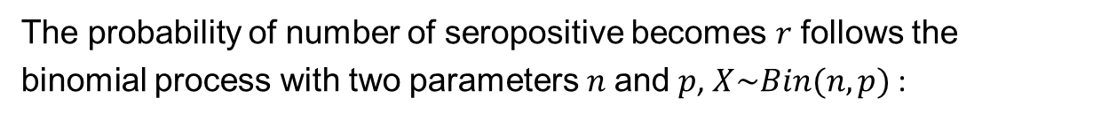
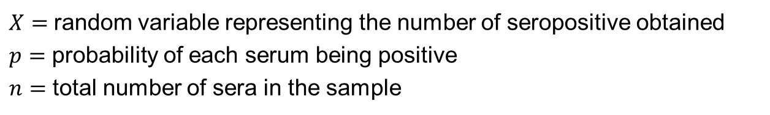
MLE - Likelihood
The probability of number of seropositive becomes $r$ follows the binomial process with two parameters $n$and $p$, $X\sim Bin(n,p)$ :
$$P\left(X=r | p,n\right)={{}_{n}^{}C}_{r}p^{r}{\left(1−p\right)}^{n−r}$$
$X=$ random variable representing the number of seropositive obtained
$p=$ probability of each serum being positive
$n=$ total number of sera in the sample
Probability $P\left(X=5 | n=10,p\right)={{}_{10}^{}C}_{5}p^{5}{\left(1−p\right)}^{5}$
$$P\left(X=5 | p=0.25\right)=0.06$$ | $$P\left(X=5 | p=0.5\right)=0.25$$ | $$P\left(X=5 | p=0.75\right)=0.06$$

Slide 18
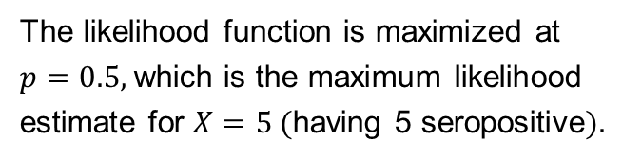

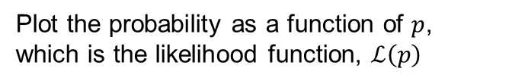
MLE - Likelihood
Plot the probability as a function of $p$, which is the likelihood function, $ℒ\left(p\right)$
$$ℒ\left(p\right)={{}_{n}^{}C}_{r}p^{r}{\left(1−p\right)}^{n−r}$$
The likelihood function is maximized at $p=0.5$, which is the maximum likelihood estimate for $X=5$ (having 5 seropositive).
Maximum likelihood estimation is a method of finding best fitting parameter values by maximizing the likelihood function of the model given the observed data.
Residual sum of squares is the maximum likelihood estimate for the model if errors around observations obey following conditions:
Errors around each observation are uncorrelated
Errors have equal variances
Errors are normally distributed

Slide 19
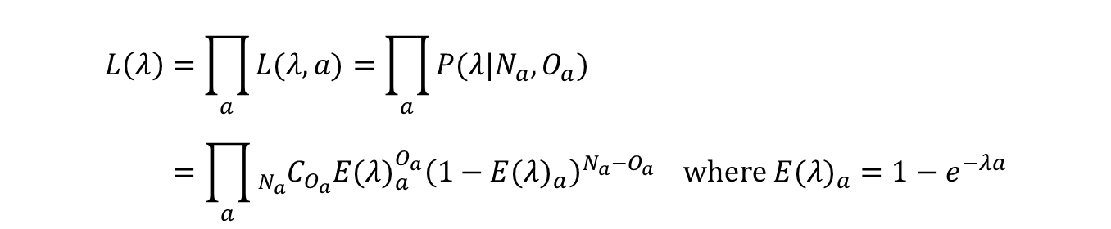
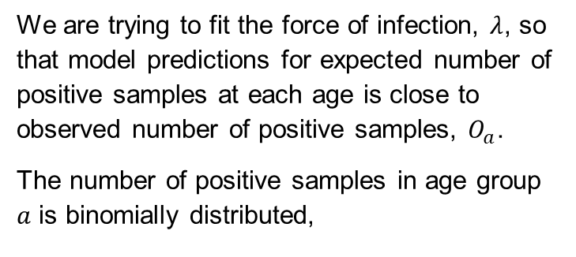

MLE – Catalytic model
1
0.9
0.8
0.7
0.6
0.5
0.4
0.3
0.2
0.1
0
We are trying to fit the force of infection, $λ$, so that model predictions for expected number of positive samples at each age is close to observed number of positive samples, $O_{a}$.
The number of positive samples in age group $a$ is binomially distributed,
Proportion positive
Observed
Predicted
$$X\sim Bin(N_{a},p_{a}).$$
0 10 20 30 40
Age (yrs)
$$L\left(λ\right)=\prod_{a}{L(λ,a)}=\prod_{a}{P(λ|N_{a},O_{a})} \\ =\prod_{a}{{}_{N_{a}}^{}{C_{O_{a}}}{E(λ)}_{a}^{O_{a}}{\left(1−{E(λ)}_{a}\right)}^{N_{a}−O_{a}} \text{where} {E(λ)}_{a}=1−e^{−λa}}$$

Slide 20

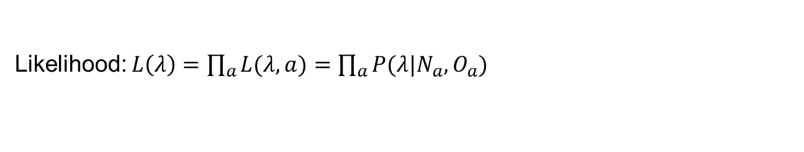
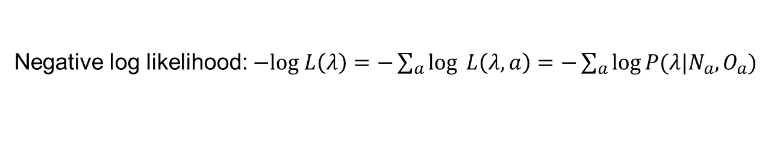
MLE – Catalytic model
Likelihood: $L\left(λ\right)=\prod_{a}{L(λ,a)}=\prod_{a}{P(λ|N_{a},O_{a})}$
The likelihood value is often extremely small for given parameters and data. It is commonly treated as log value for computational convenience.
Log likelihood: $log L\left(λ\right)=\sum_{a}{\log{ L(λ,a)}}=\sum_{a}{\log{P(λ|N_{a},O_{a})}}$
Since log likelihood always takes negative value, negative log likelihood is commonly used.
Negative log likelihood: $−log L\left(λ\right)=−\sum_{a}{\log{ L\left(λ,a\right)}}=−\sum_{a}{\log{P(λ|N_{a},O_{a})}}$

Slide 21
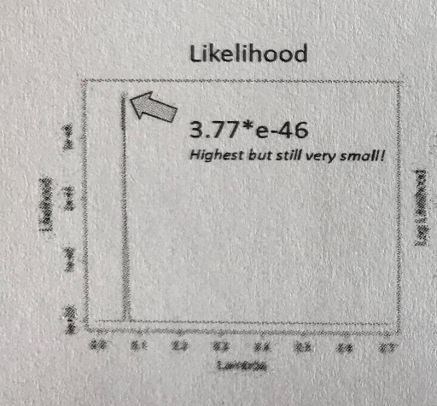
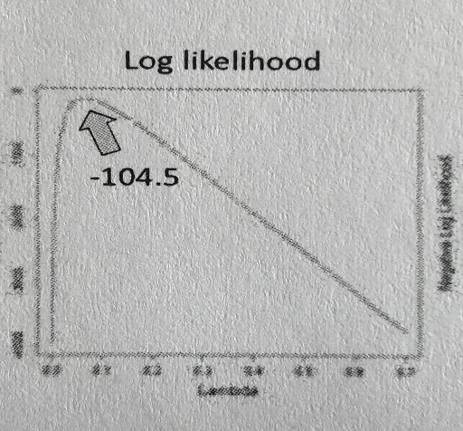
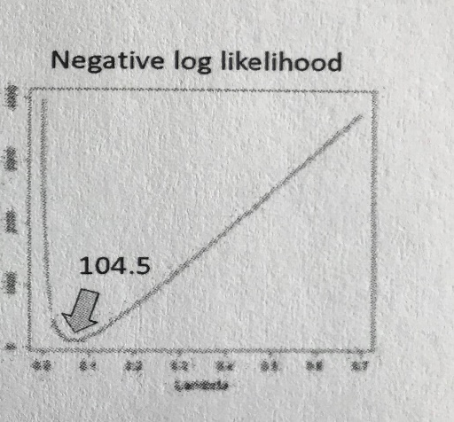
MLE – Catalytic model
1
0.9
0.8
0.7
0.6
0.5
0.4
0.3
0.2
0.1
0
Proportion positive
Observed
Predicted
0 10 20 30 40
Age (yrs)

Slide 22


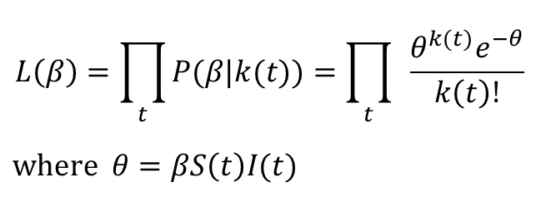
MLE – SIR model
Fit to SIR model incidence data to estimate transmission rate $β$
$$λ$$
I
Infectious
$$r$$
R
Recovered
S
Susceptible
Number of incidence $k(t)$ follows the poisson distribution $X\sim Pois(θ)$
$$L\left(β\right)=\prod_{t}{P(β|k(t))=\prod_{t}{ \frac{θ^{k(t)}e^{−θ}}{k\left(t\right)!} }}$$
$$\text{where} θ=βS\left(t\right)I(t)$$

Slide 23
MLE - Uncertainty
Why the binomial process is applied in the likelihood of the catalytic model example?
Likelihood function consists of estimation and stochasticity.
Stochastic model in the likelihood function describes how uncertainty (variability) occurs in the system to be modelled.
Choice of stochastic model defines the origin of uncertainty in the system.
Event | Stochastic model choice
Proportional event, test result | Binomial
Multi branch process | Multinomial
Rare event | Poisson, Negative binomial
Aggregation of multiple numerical event | Normal
Doubling process | Log-normal

Slide 24
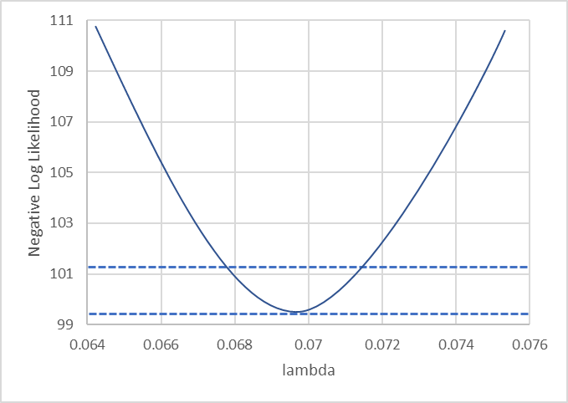
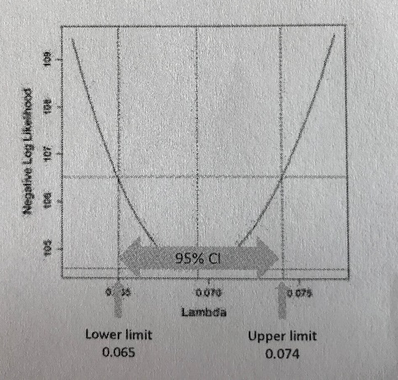
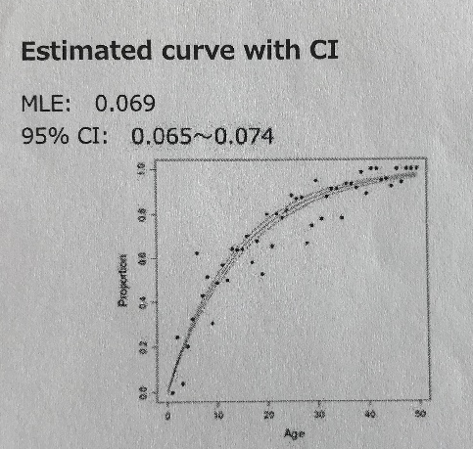
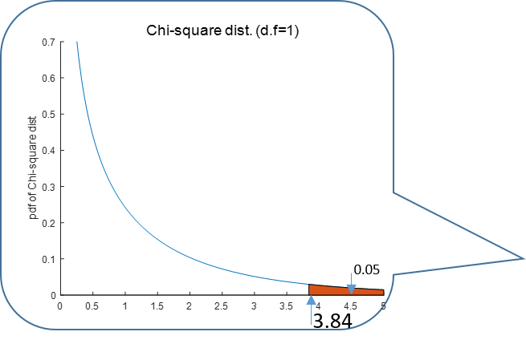
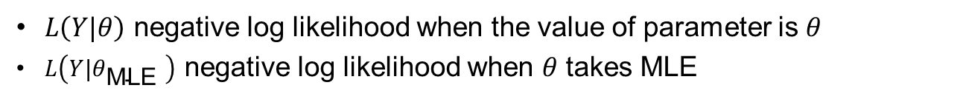

MLE - Uncertainty
Confidence interval in MLE using Chi-square distribution
$L\left(Y|θ\right)$ negative log likelihood when the value of parameter is $θ$
$L\left(Y|θ_{\text{MLE} }\right)$ negative log likelihood when $θ$ takes MLE
$$R\left(θ\right)=2\left[L\left(Y|θ\right)−L\left(Y|θ_{\text{MLE} }\right)\right]$$
has a Chi-square distribution with one degree of freedom for given data $Y$
1.92

Slide 25
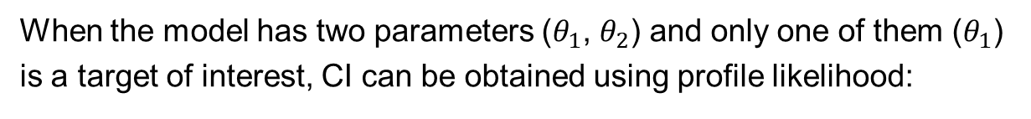
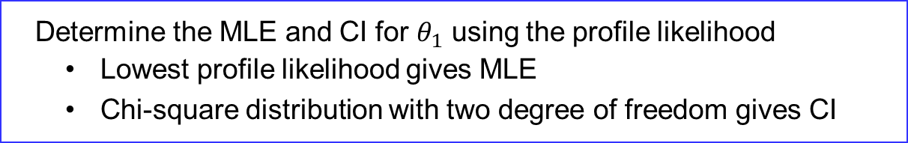
MLE - Uncertainty
Confidence interval in MLE using profile likelihood
When the model has two parameters ($θ_{1}$, $θ_{2}$) and only one of them ($θ_{1}$) is a target of interest, CI can be obtained using profile likelihood:
Find MLE of $θ_{2}$ when $θ_{1}$ is fixed as $k$ and obtain the lowest nLL
Repeat for enough values of $θ_{1}$ to plot the graph of nLL
Determine the MLE and CI for $θ_{1}$ using the profile likelihood
Lowest profile likelihood gives MLE
Chi-square distribution with two degree of freedom gives CI

Slide 26
MLE - Uncertainty
Confidence interval in MLE using Bootstrapping

Slide 27
Bayesian inference
A medical doctor examines a patient and wants to find out if it is caused by Malaria by asking “What’s your problem/symptom?”
Answer | Cause of high fever
I have high fever. | • common cold… 70%? • Influenza… 20%? • Malaria… 5%?
I have high fever since I came back from South Africa. | • common cold… 50%? • Influenza… 10%? • Malaria… 30%?

Slide 28
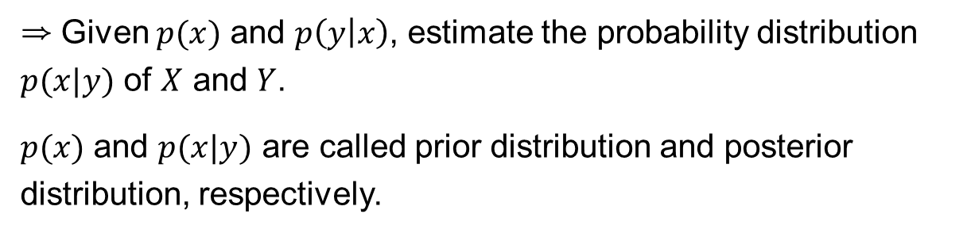
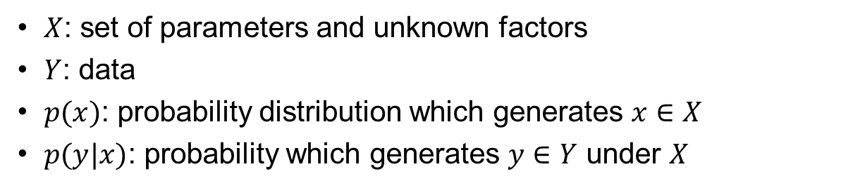
Bayesian inference
$X$: set of parameters and unknown factors
$Y$: data
$p(x)$: probability distribution which generates $x∈X$
$p(y|x)$: probability which generates $y∈Y$ under $X$
⇒ Given $p(x)$ and $p\left(y | x\right)$, estimate the probability distribution $p(x|y)$ of $X$ and $Y$.
$p(x)$ and $p(x|y)$ are called prior distribution and posterior distribution, respectively.

Slide 29
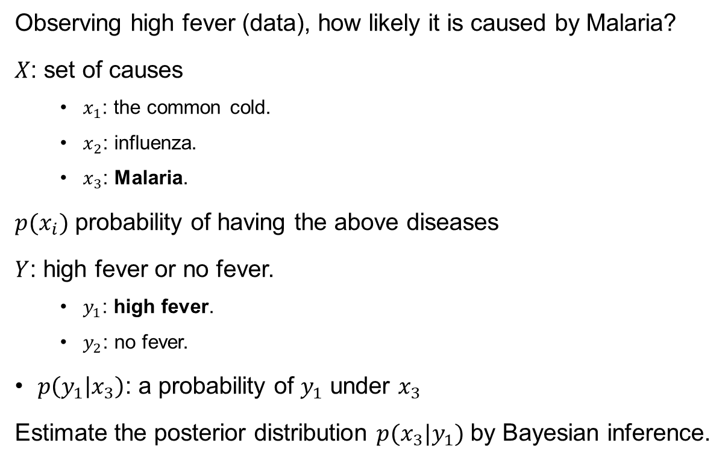
Bayesian inference
Observing high fever (data), how likely it is caused by Malaria?
$X$: set of causes
$x_{1}$: the common cold.
$x_{2}$: influenza.
$x_{3}$: Malaria.
$p(x_{i})$ probability of having the above diseases
$Y$: high fever or no fever.
$y_{1}$: high fever.
$y_{2}$: no fever.
$p\left(y_{1} | x_{3}\right)$: a probability of $y_{1}$ under $x_{3}$
Estimate the posterior distribution $p(x_{3}|y_{1})$ by Bayesian inference.

Slide 30

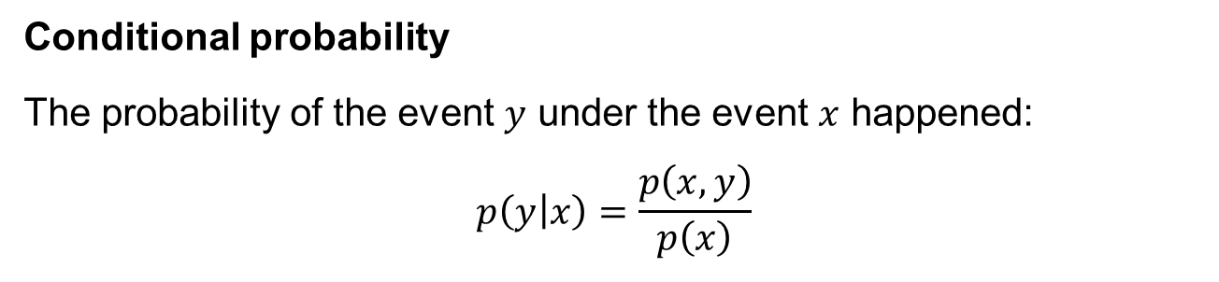
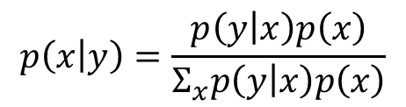
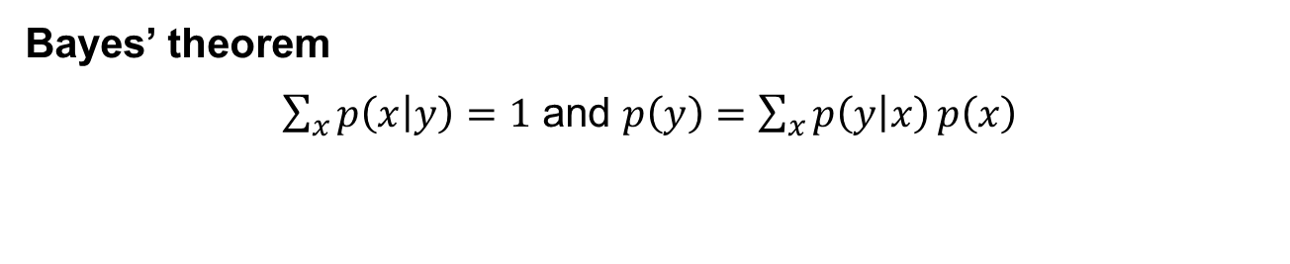
Bayes’ theorem
Conditional probability
The probability of the event $y$ under the event $x$ happened:
$$p\left(y | x\right)=\frac{p\left(x, y\right)}{p\left(x\right)}$$
⇒ $p\left(x | y\right)p\left(y\right)=p\left(x,y\right)=p\left(y | x\right)p\left(x\right)$
Bayes’ theorem
$\sum_{x}{p\left(x | y\right)=1}$ and $p\left(y\right)=\sum_{x}{p\left(y | x\right)}p\left(x\right)$
$$p\left(x | y\right)=\frac{p\left(y | x\right)p\left(x\right)}{Σ_{x}p\left(y | x\right)p\left(x\right)}$$

Slide 31
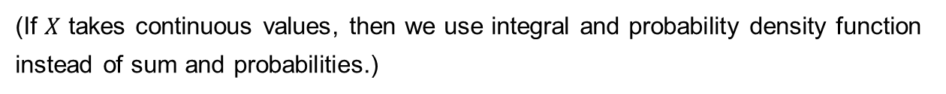

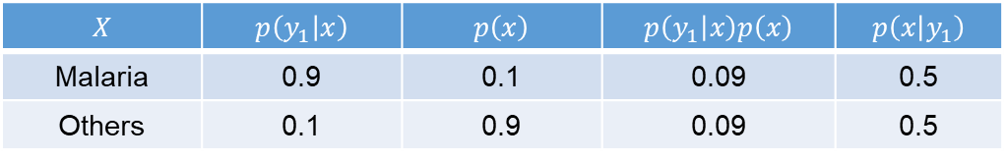
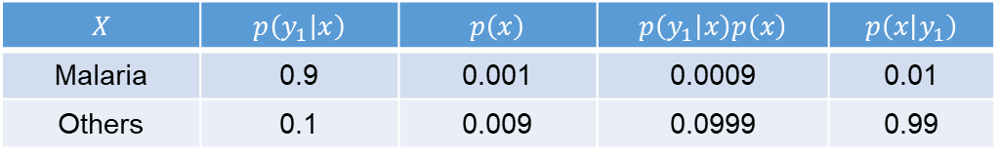
Bayesian inference
The posterior probability that high fever is caused by Malaria
$$p\left(x_{3} | y_{1}\right)=\frac{p\left(y_{1} | x_{3}\right)p\left(x_{3}\right)}{\sum_{x_{i}}{p\left(y_{1} | x_{i}\right)p(x_{i})}}.$$
(If $X$ takes continuous values, then we use integral and probability density function instead of sum and probabilities.)
$$X$$ | $$p\left(y_{1} | x\right)$$ | $$p\left(x\right)$$ | $$p\left(y_{1} | x\right)p\left(x\right)$$ | $$p\left(x | y_{1}\right)$$
Malaria | 0.9 | 0.001 | 0.0009 | 0.01
Others | 0.1 | 0.009 | 0.0999 | 0.99
≈
$$X$$ | $$p\left(y_{1} | x\right)$$ | $$p\left(x\right)$$ | $$p\left(y_{1} | x\right)p\left(x\right)$$ | $$p\left(x | y_{1}\right)$$
Malaria | 0.9 | 0.1 | 0.09 | 0.5
Others | 0.1 | 0.9 | 0.09 | 0.5
≈
The prior probability $p\left(x\right)$ has large impact on the posterior distribution!

Slide 32
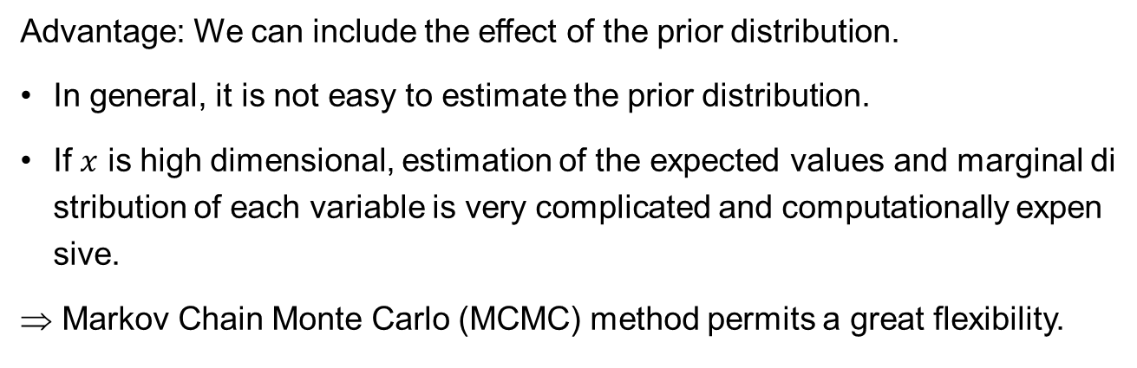
Bayesian inference
Advantage: We can include the effect of the prior distribution.
In general, it is not easy to estimate the prior distribution.
If $x$ is high dimensional, estimation of the expected values and marginal distribution of each variable is very complicated and computationally expensive.
Markov Chain Monte Carlo (MCMC) method permits a great flexibility.
A Markov chain is a random process that undergoes transitions from one state to another where the probability distribution of the next state depends only on the current state.
Monte Carlo method is a method for simulation using random numbers.

Slide 33
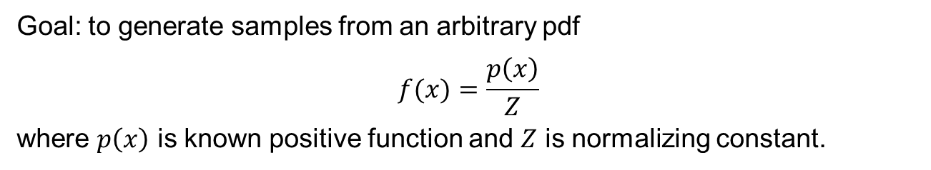
Markov Chain Monte Carlo
A generic method for approximating sampling from an arbitrary distribution.
Main idea is to generate a Markov chain whose limiting distribution is equal to the desired distribution.
Metropolis-Hastings algorithm
introduced by Metropolis et al. (1953) and generalized by Hastings (1970)
Gibbs sampler
introduced by Josiah Willard Gibbs et al. (1984)
Goal: to generate samples from an arbitrary pdf
$$f(x)=\frac{p\left(x\right)}{Z}$$
where $p\left(x\right)$ is known positive function and $Z$ is normalizing constant.

Slide 34
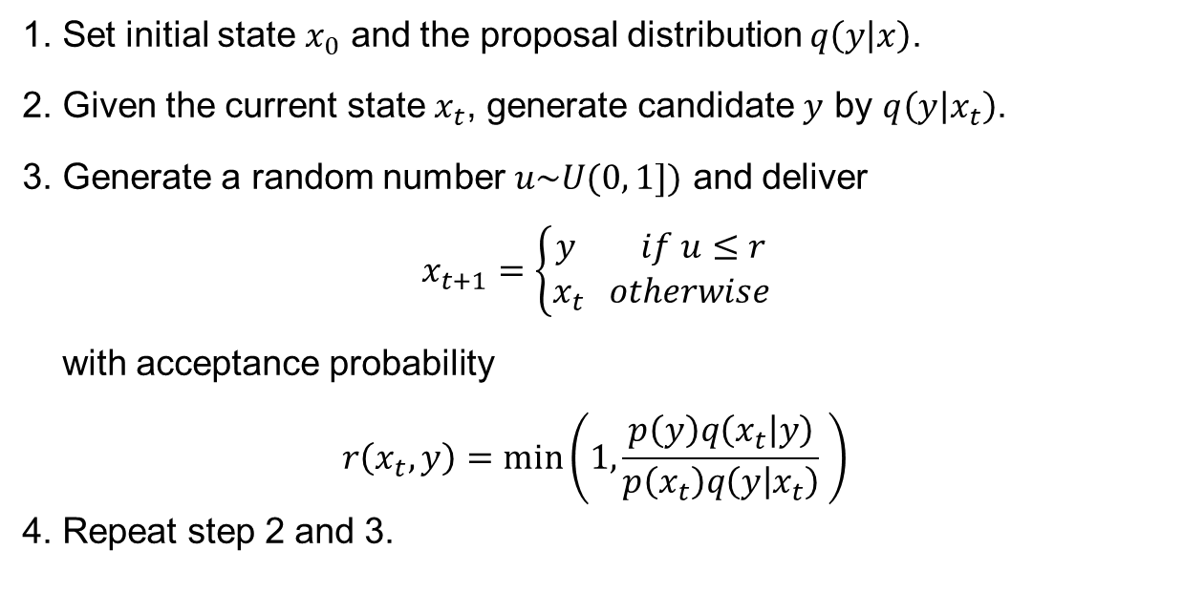
Metropolis-Hastings algorithm
1. Set initial state $x_{0}$ and the proposal distribution $q\left(y | x\right)$.
2. Given the current state $x_{t}$, generate candidate $y$ by $q\left(y | x_{t}\right)$.
3. Generate a random number $u\sim U(0, 1])$ and deliver
$$x_{t+1}=\left\{\begin{matrix}y if u≤r \\ x_{t} otherwise\end{matrix}\right.$$
with acceptance probability
$$r\left(x_{t},y\right)=\min\left(1, \frac{p\left(y\right)q\left(x_{t} | y\right)}{p\left(x_{t}\right)q\left(y | x_{t}\right)} \right)$$
4. Repeat step 2 and 3.
Notes:
We may replace f by g.

Slide 35
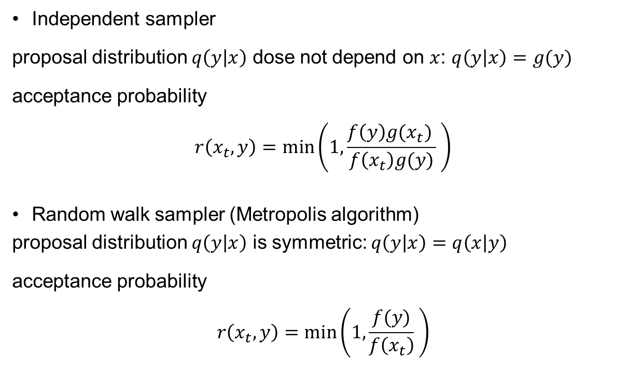
Metropolis-Hastings algorithm
Independent sampler
proposal distribution $q\left(y | x\right)$ dose not depend on $x$: $q\left(y | x\right)=g(y)$
acceptance probability
$$r\left(x_{t},y\right)=\min\left(1, \frac{f\left(y\right)g(x_{t}) }{f\left(x_{t}\right)g(y)} \right)$$
Random walk sampler (Metropolis algorithm)
proposal distribution $q\left(y | x\right)$ is symmetric: $q\left(y | x\right)=q\left(x | y\right)$
acceptance probability
$$r\left(x_{t},y\right)=\min\left(1, \frac{f(y)}{f\left(x_{t}\right)} \right)$$
Notes:
We may replace f by g.

Slide 36

Gibbs sampler
A particular case of the Metropolis-Hastings algorithm for generating $n$-dimensional random vectors.
Goal: to generate a random vector $x=(x_{1},⋯{,x}_{n})$ according to a target pdf $f\left(x\right).$
1. Set initial state $x_{0}$.
2. Given the current state $x_{t}$, generate $y=(y_{1},⋯{,y}_{n})$ as follows:
Draw $y_{1}$ from the conditional pdf $f\left(x_{1} | x_{t1},⋯{,x}_{tn}\right)$
Draw $y_{i}$ from $f\left(x_{i} | y_{1},⋯{,y}_{i−1}{,x}_{ti+1}⋯{,x}_{tn}\right)$
Draw $y_{n}$ from $f\left(x_{n} | y_{1},⋯{,y}_{n−1}\right)$
Let $x_{t+1}=y$.
3. Repeat step 2.

Slide 37

MCMC - Example
$Y$ a set of observations: $Y=\left(y_{1},y_{2},⋯,y_{N}\right)$.
$N$ samples which follow Poisson distribution with parameter $λ$.
Likelihood function $L\left(λ\right)$ is given by
$$L\left(λ\right)=\prod_{i=1}^{N}{\frac{λ^{y_{i}}\exp\left(−λ\right)}{y_{i}!}}.$$ Log-likelihood function is
$$\log\left(L\left(λ\right)\right)=\sum_{i=1}^{N}{\left\{y_{i}\log{λ}−λ−\log\left(y_{i}!\right)\right\}}.$$

Slide 38






MCMC – Example
Influence of iteration numbers: $λ_{0}=4$ and $N=100$
100 times iteration
1000 times iteration
100000 times iteration
Notes:
(Red line with the exact value $λ=3.5$)
As the number of iteration becomes larger, the probability distribution seems to follow some distribution.
Stationary distribution
The goal of MCMC is that the posterior distribution coincides with the stationary distribution.
It may take quite a long time to obtain stationary distribution.

Slide 39




MCMC – Example
Influence of initial value
Burn-in samples
$λ_{0}=$ 1, 2, 3, 4, 5, 6 and $N=100$
(100 times iteration)
$λ_{0}=6$ and $N=100$ (250 times iteration)

Slide 40
Markov Chain Monte Carlo
Efficient method to explore higher dimensional parametric space.
Even if the target distribution is bimodal, MCMC can find global maximum.
There are lots of software and the algorithms are also simple.
 | Frequentist | Bayesian
Probability | Measure of the frequency of repeated events | Measure of degree of certainty about values
Parameters Data | Fixed Random | Fixed Random
CI | When Confidence Interval is computed 100 times, at least 95 will be expected to include the true value of the parameter | 95% probability that the true value of the parameter falls with in Credible Interval
Notes:
MCMC estimates the posterior distribution of a set of parameter without having to explore the whole parameter space
Different starting points (initial value) may lead to different estimated results. MCMC can escape local maximum and reach global maximum.
Available packages and software by R:
MCMC pack
mcmc
Brugs, R2WinBugs(BUGS)
rstan(stan)
abc
easyABC

Slide 41

Parameter estimation
Method | LSM | MLE | Bayesian
results for parameter | mean | mean confidence interval | probability distribution
required information | data | data distribution for data | data distribution for data prior of parameter
key formula | $$\sum_{i}{{\left(E_{i}\left(x\right)−O_{i}\right)}^{2}}$$ | likelihood $ℒ\left(p\right)$ | $$p\left(x | y\right)=p\left(y | x\right)p\left(x\right)$$

Slide 42
Supplement Information

Slide 43

Maximum likelihood - model deviance
The likelihood function tells us that we have found the “best fitting” parameters when we have maximized the likelihood. However, a different model may allow us to get an even better fit to data.
One extreme is a model with a separate variable for every data point that would reproduce the data perfectly but at the cost of not giving us any useful insight at all. Such a model is called a saturated model.
The model deviance $D$compares the goodness of fit of a model with that of the saturated model, and is defined by
$D=−2\text{log}\frac{L\left(λ\right)}{L\left(\hat{λ}\right)}$ $L\left(λ\right)=$ model likelihood
$L\left(\hat{λ}\right)=$ saturated likelihood

Slide 44

Maximum likelihood - model deviance
Useful properties of the deviance
If we have two models M1 and M2 then we can find the difference
(deviance of M1) – (deviance of M2)
This is $χ^{2}$-distributed with degrees of freedom equal to
(number of parameters in M1) – (number of parameters in M2)
Calculate confidence intervals around best fitting parameters.
Test hypotheses (are additional parameters in a more complex model significant?).
Choose the most parsimonious model using criteria such as the Akaike Information Criterion (AIC).

Slide 45

Example: Catalytic Model
Model log likelihood
$$\text{log}L\left(λ\right)=\text{log}\prod_{a}{{{}_{N_{a}}^{}C}_{O_{a}}}p_{a}^{O_{a}}{\left(1−p_{a}\right)}^{N_{a}−O_{a}}$$
$=\sum_{a}{O_{a}\text{log}p_{a}}+\left(N_{a}−O_{a}\right)\text{log}\left(1−p_{a}\right)+\text{log}{}_{N_{a}}^{}{C_{O_{a}} \text{where} p_{a}=E_{a}(λ)/N_{a}}$
Saturated log likelihood
$$\text{log}L\left(λ\right)=\text{log}\prod_{a}{{{}_{N_{a}}^{}C}_{O_{a}}}{\hat{p}}_{a}^{O_{a}}{\left(1−{\hat{p}}_{a}\right)}^{N_{a}−O_{a}}$$
$=\sum_{a}{O_{a}\text{log}{\hat{p}}_{a}}+\left(N_{a}−O_{a}\right)\text{log}\left(1−{\hat{p}}_{a}\right)+\text{log}{}_{N_{a}}^{}{C_{O_{a} }\text{where} {\hat{p}}_{a}=O_{a}/N_{a}}$
Deviance $D=2(\text{log}L\left(\hat{λ}\right)−\text{log}L\left(λ\right))$
Constants will cancel out

Slide 46

MCMC: Acceptance-rejection algorithm
target density: the functional form of the density $f$ of interest.
candidate density: a simple density $g$ to generate the random variable for which the simulation is actually done. The density $g$ needs to satisfy:
$f$ and $g$ have compatible supports. (i.e., $g(x)>0$ when $f(x)>0$)
There is a constant $M$ with $\frac{f\left(x\right)}{g\left(x\right)}<M$for all $x$.

Slide 47

Acceptance-rejection method

Slide 48

Acceptance-rejection method
Idea: $X$ is the random number to be obtained.
Generate $Y\sim g$ and independently generate $u\sim U_{[0,1]}$.
Accept $X=Y$, if $u≤\frac{1}{M}\frac{f\left(Y\right)}{g\left(Y\right)}$
Return to 1 until enough number of $X$ generated.
The algorithm is quite simple, however, many rejections occur until getting enough number of samples. $⋯$ not so efficient.

Slide 49

Metropolis-Hastings algorithm
$g\left(x^{′} | x\right)$: the transition probability
$p\left(λ^{′} | λ_{0}\right)$: the proposal distribution, the conditional probability of proposing a state $λ′$ given $λ_{0}$
$r(λ^{′},λ_{0})$: acceptance ratio, the probability to accept the proposed state $λ′$.
The transition probability can be written as:
$$g\left(x^{′} | x\right)=p\left(λ^{′} | λ_{0}\right)r\left(λ^{′},λ_{0}\right)$$
Then, from $π\left(λ_{0}\right)g\left(λ^{′} | λ_{0}\right)=π\left(λ^{′}\right)g\left(λ_{0} | λ^{′}\right)$,
$$\frac{r\left(λ^{′},λ_{0}\right)}{r\left(λ_{0},λ^{′}\right)}=\frac{π\left(λ^{′}\right)}{π\left(λ_{0}\right)}⋅\frac{p\left(λ_{0} | λ^{′}\right)}{p\left(λ^{′} | λ_{0}\right)}.$$
One common choice to choose an acceptance ratio that fulfills the condition above is:
$$r\left(λ^{′},λ_{0}\right)=\min\left(1,\frac{π\left(λ^{′}\right)}{π\left(λ_{0}\right)}⋅\frac{p\left(λ_{0} | λ^{′}\right)}{p\left(λ^{′} | λ_{0}\right)}\right).$$

Slide 50
Optimization algorithm
MATLAB function | Algorithm | 특징
fminsearch | Nelder-Mead | Direct search
fminbnd
simulannealbnd
 | Newton | Gradient method
 | Steepest descent | Gradient method

